Slide 1
Air Pollution Data Modelling
Lorcan Donnellan
19/3/2025
Notes:
According to the World Health Organization, air pollution contributes to over 7 million premature deaths annually. But pollution is not evenly distributed—it fluctuates by location, time of day, and even season. My analysis focuses on identifying these variations using spatial mapping and temporal trends, helping us understand when and where air quality is most concerning, so that we can adapt to our circumstances accordingly.

Slide 2
Why is it important to be air aware?
A few figures
99%
50%
5x
Notes:
Around 99% of the global population breathes air that exceeds World Health Organization's air quality limits, with people
in low and middle-income countries being most exposed to pollution, according to the UN agency's latest database.
Road traffic contributes to over 50% of NO₂ emissions in cities (DEFRA, 2023).
Studies show that pollution levels can be 5x higher on busy streets compared to nearby parks.
These statistics clearly illustrate the severity of air pollution and its disproportionate impact on urban areas.
With road traffic being a major contributor and pollution levels fluctuating significantly by location, it’s crucial to
understand when and where air quality is at its worst, because it’s basically impossible to avoid all the time in london.
This knowledge is especially important for protecting vulnerable populations, like children, and
making informed decisions about school placements, daily commutes, and city planning.
That’s why my analysis focuses on identifying these spatial and temporal pollution patterns—to provide insights that
can help individuals and policymakers minimize exposure and make healthier choices.

Slide 3

Data and Methods
Breathe London AQ Mesh Pods.
Refined the data: What did we do with nulls? What columns did we keep? How did we self-generate the data based on the real dataset?
Simulating health data
Notes:
I used Breathe London AQ mesh pods dataset as the primary source for NO2 and PM2.5 measurements.
This dataset contains hourly air quality measurements from mesh pods spread across London.
Data contained many different features but as we wanted to focus on pollutants NO2 and PM2.5 we refined the data to our pollutant measurements, date-time, location.
We dropped rows containing null measurements. There were quite a few, we ended up shedding 25% of the data, reasoning that we were tasked with creatting an imperfect dataset so this dataset would still be fit for purpose. We added random noise to make our dataset hypothetical thus fulfilling the brief given to us. Finally we simulated health data using implied relationships found in other research. This was something I’d planned to go back and change to make more realistic, but never got the time.
We now had a dataset with over 600,000 hourly datapoints for NO2 and PM2.5 ready to analyse.

Slide 4
Initial Data Analysis
PM2.5 (µg/m³): Mean: 11.93 Std Dev: 12.69 Reflects moderate urban pollution, with significant variation across locations.
NO2 (µg/m³): Mean: 38.25 Std Dev: 23.20 Common in urban areas, with high variability influenced by traffic and weather.
Notes:
The WHO recommends an annual mean of less than 5 µg/m³ for PM2.5 and less than 10 µg/m³ for NO2. In comparison, our dataset shows a mean PM2.5 concentration of 11.93 µg/m³, over twice the recommended limit, indicating moderate air pollution. The mean NO2 concentration of 38.25 µg/m³ is almost four times the WHO's annual limit, suggesting significant pollution, likely from traffic and industrial sources. Both pollutants exceed WHO guidelines, highlighting the need for stricter air quality measures.
Pearson Correlation: 0.399 weak positive correlation

Slide 5
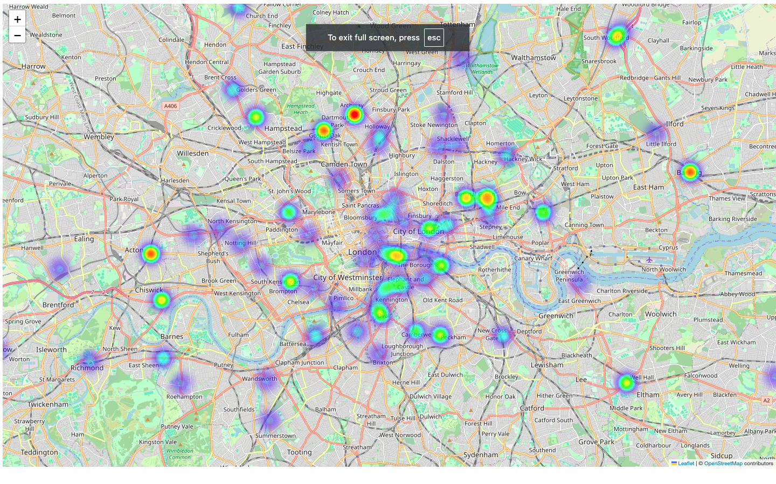
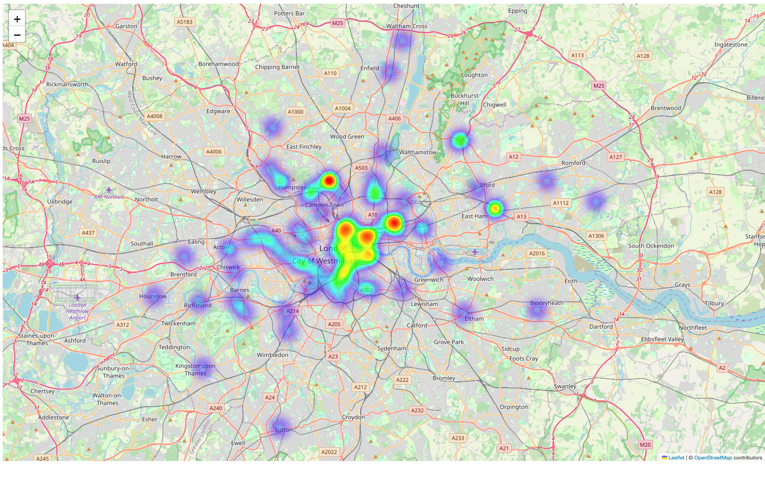
Spatial Analysis
27 locations had NO2 means above 40 µg/m³, the highest WHO threshold, making these areas less desirable to live in. Six locations exceeded 50 µg/m³, with one (London Wall) surpassing 60 µg/m³.
Even the locations with the lowest averages (Wyndham Road, Bonington Road, Triangle Adventure Playground) had averages over 24µg/m³.
We generated interactive heat maps for PM2.5 (left) and NO2 (right) clearly showing pollutant hotspots across London:
Notes:
27 locations had NO2 means above 40 µg/m³, the highest WHO threshold, making these areas less desirable to live in.
Six locations exceeded 50 µg/m³, with one (London Wall) surpassing 60 µg/m³. Prolonged exposure in these areas
could lead to respiratory issues, cardiovascular diseases, and increased risk of lung cancer.
Even the locations with the lowest averages (Wyndham Road, Bonington Road, Triangle Adventure Playground)
had averages over 24µg/m³.
Knowing which locations are in general less air polluted can be integral part of building family life for example, which schools to go to and which ways to commute. We were also able to show which region had generally less pollution and found locations in South East and South West had generally lower averages.
We took this one step further with the heat map. We clearly see No2 pollution unsurprisingly increases nearer the inner city. There are also other notable hotspots further out, like Upper Holloway and Barking which were found near industrial estates which can explain their high measures. Tower Bridge Road was a hotspot, expectedly due to the business of this bridge. More locations near the M25 would have been useful to see effects of traffic on the busiest road in the UK.
The interactive heat map is an example of a tool a commuter with chest issues could use to avoid pollutant heavy areas, a parent could use when deciding where to send their
Kid with asthma to school, Local authorities can use heat maps to track pollution hotspots and assess the effectiveness of air quality control measures (e.g., low-emission zones, traffic regulations). They can use the data to inform policy decisions such as where to implement stricter traffic controls or set up green spaces.
The PM2.5 hotspots are more dispersed than NO2 hotspots because PM2.5 comes from a wide range of sources, including traffic, industry, construction, and residential heating, which are spread across a city. Additionally, PM2.5 particles are small and can travel long distances, allowing pollution to spread out more widely. In contrast, NO2 is mainly produced by vehicle emissions and industrial activity, leading to more localized hotspots around busy roads and industrial zones. NO2 also tends to dissipate more quickly and is less influenced by seasonal or weather changes, resulting in more concentrated pollution areas.

Slide 6
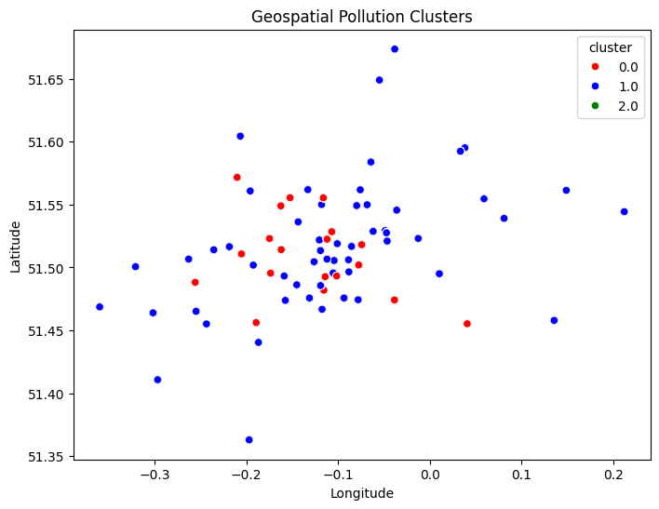
Spatial Analysis: K Means Clustering
We used K-means clustering to groups locations into low, medium, and high pollution zones. This Highlights pollution hotspots (e.g., near traffic, factories). Shows cleaner routes (for running/cycling). Found a lot of hotspots towards the center of the city.
Notes:
Weren’t able to impose this k means clustering on an actual map which would have been useful due to computational restrictions, however, this shows we can create more generalised figures for higher view planning at governmental level.

Slide 7
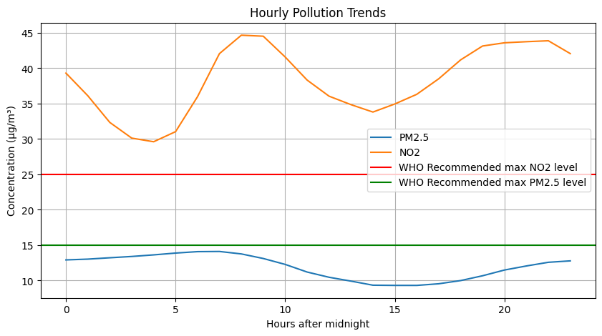
Temporal Trends
Diagram included hourly means for each pollutant and highest WHO recommended hourly levels for each.
The WHO recommends 24-hour average levels of NO2 and PM2.5 to be 25 µg/m3 and 15 µg/m3to protect human health.
We clearly see rush hour spikes.
Notes:
The data shows that NO2 levels are lowest between 3-5 am, with peaks during rush hour (8-9 am) and a second spike at 10 pm, likely due to traffic and industrial activity. PM2.5 levels are lowest between 2-4 am and highest between 4-8 am, generally being higher in the morning than in the evening. This is due to heavier traffic and industrial emissions, as well as less atmospheric dispersion in the morning. Temperature inversions during early morning hours also trap pollutants near the ground, leading to lower levels of both pollutants. Joggers and cyclists should avoid peak times to reduce exposure to harmful pollutants.
In general NO2 levels much higher than recommended and PM2.5 slightly lower than recommended, showing that perhaps traffck and fossil fuel burning is the primarily challenge for London.

Slide 8
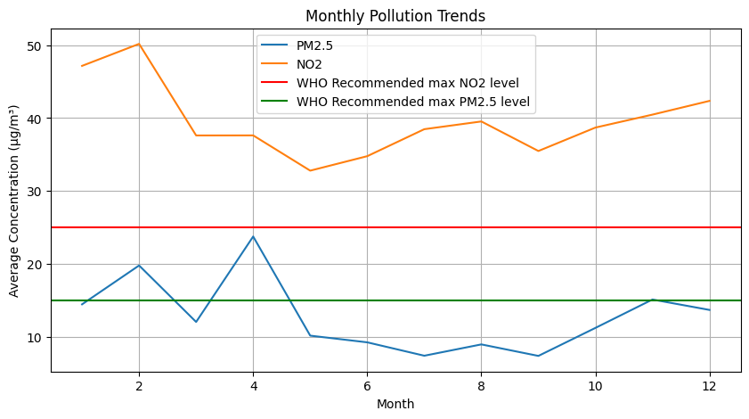
Temporal Trends
Diagram included monthly means for each pollutant and highest WHO recommended daily levels for each.
The WHO recommends 24-hour average levels of NO2 and PM2.5 to be 25 µg/m3 and 15 µg/m3to protect human health.
Air quality better in spring and summer months than autumn and winter months.
Notes:
In the graph, we can see that air quality is generally better in the spring and summer months compared to autumn and winter. This is primarily due to warmer temperatures in the warmer months, which help disperse pollutants more effectively, preventing them from accumulating near the ground. In contrast, colder temperatures during autumn and winter often lead to temperature inversions, trapping pollutants at ground level. Additionally, heating emissions are higher in winter due to the use of boilers and stoves, which contribute significantly to pollutants like PM2.5. In the warmer months, these emissions decrease, and plants help absorb some pollutants through increased photosynthesis, leading to better air quality.

Slide 9
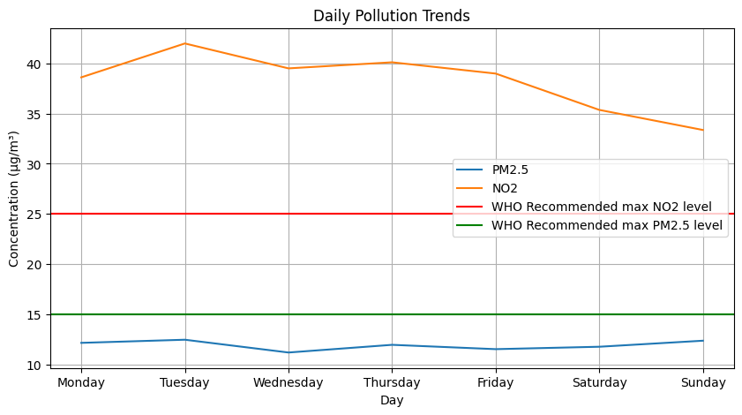
Temporal Trends
Diagram included daily means for each pollutant and highest WHO recommended daily levels for each.
The WHO recommends 24-hour average levels of NO2 and PM2.5 to be 25 µg/m3 and 15 µg/m3to protect human health.
Found lower levels of pollutants at weekends.
Notes:
We found lower levels of pollutants on weekends, which is likely due to a few factors. First, there’s generally less traffic on weekends, as fewer people are commuting to work or school, which reduces emissions from vehicles, especially NO2. Additionally, industrial activity tends to be lower over the weekend, as many factories and businesses operate at reduced capacity or shut down. With these sources of pollution reduced, air quality improves, leading to lower pollutant levels.

Slide 10
Key Findings
We found general levels of pollutants in London was higher than recommended WHO level.
We found we could create interactive heat maps of pollutant hotspots.
We found we could create K means clustering to create a more concise snapshot of the city as a whole which may be useful to governmental planning.
We were able to pinpoint daily, weekly, and yearly high and low points in pollutant levels.

Slide 11
Limitations and Future Work
Incorporating additional variables and making health measurements more realistic: machine learning modelling, feature importance, causa inference, and regression techniques.
Ratio analysis: identify patterns, assess the impact of specific pollution sources, and highlight areas with disproportionate pollutant levels, aiding in targeted interventions and better understanding of their combined effects on health.
Taxi Detector Data: insight into effect of big events and definite traffic.
Changes between British Summer Time (BST) and Greenwich Mean Time (GMT): Occur twice per year., providing an opportunity to identify sources whose emissions and inputs are specifically linked to daytime working patterns.
Notes:
Because of how we simulated the health metrics, the analysis was not very interesting so I opted not to include it in the presentation.To improve the model, I could have incorporated variables like temperature, humidity, elevation, running pace, and factors like fitness level, fatigue, and terrain. Using physiological datasets, I could have joined data based on time of day and applied machine learning to model the effects of NO₂, PM2.5, temperature, and running pace on health metrics. This would enable analysis using feature importance, causal inference, and regression techniques, along with interaction effects and partial dependency plots to identify key factors and their impact.
I read about Ratio Analysis and it would have been good for identifying patterns and potential sources of pollutants.
Taxi detector data for seeing the effects of big events and traffic
Changes in time to see difference between BST and GMT, try to identify precise links to daytime working hours.

Slide 12
Conclusions
Results mean different things for different subgroups. Let’s expand.
Athletes: Should consider where they exercise and when using tools similar to the heat maps shown, like Air Aware Lab’s Air Tracker, to protect their respiratory health and maintain peak performance.
Commuters: Heat maps provide a tool for route planning when avoiding peak times isn’t possible.
NHS Staff: NHS staff could adjust working hours, ventilation settings, or even recommend certain precautions (e.g., wearing masks) for patients who may be vulnerable to pollution. They may also use the map to prioritize resources in areas with higher health risks.
Local Authorities: They could use heat maps and clustering to direct investments in urban planning, transportation, and environmental regulations, such as improving air quality in areas where pollution is highest. They could also issue alerts to the public during high pollution events, guiding them to take protective actions. They can also use maps to assess whether measures like congestion charges are working in inner city.

Slide 13
Thank you for your time!

